Slide 1
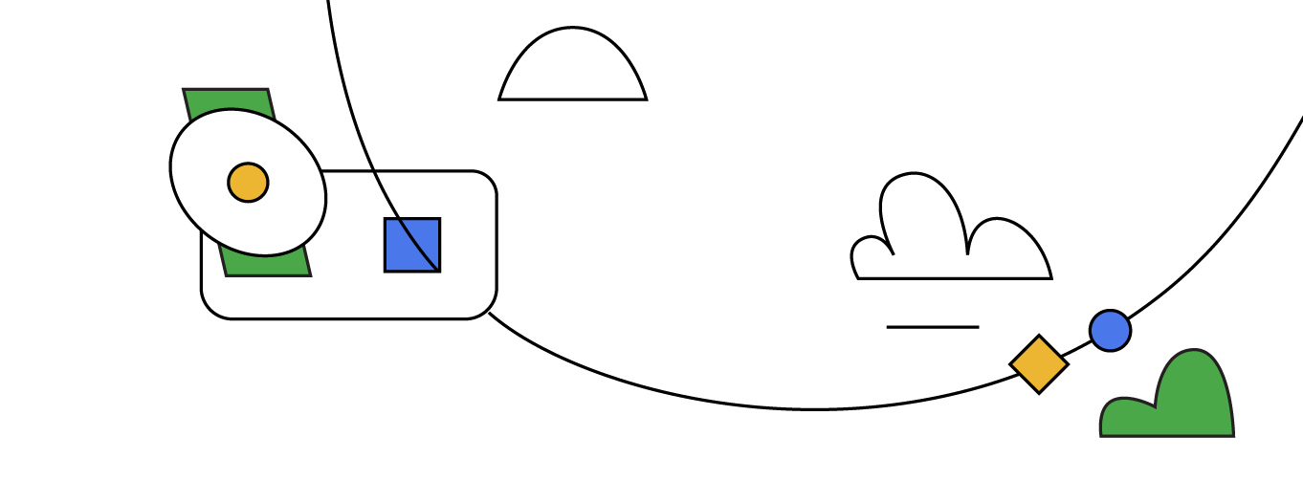


How to win a Data Science Competition
Mohammed Eltayeb

Slide 2

Table of Contents
Introduction to Kaggle
Exploring AI Competitions
Mastering AI Competitions: Understand your Toolkit
Choosing the Best Models
Practical Tips and Strategies

Slide 3

Introduction to Kaggle
Welcome onboard kagglers Kaggle.com

Slide 4

The Biggest AI community!
Hosting AI competitions, datasets, notebooks, models, tutorials and a lot more.
Best place to learn the practical part of AI.
Ranks and Tiers.

Slide 5
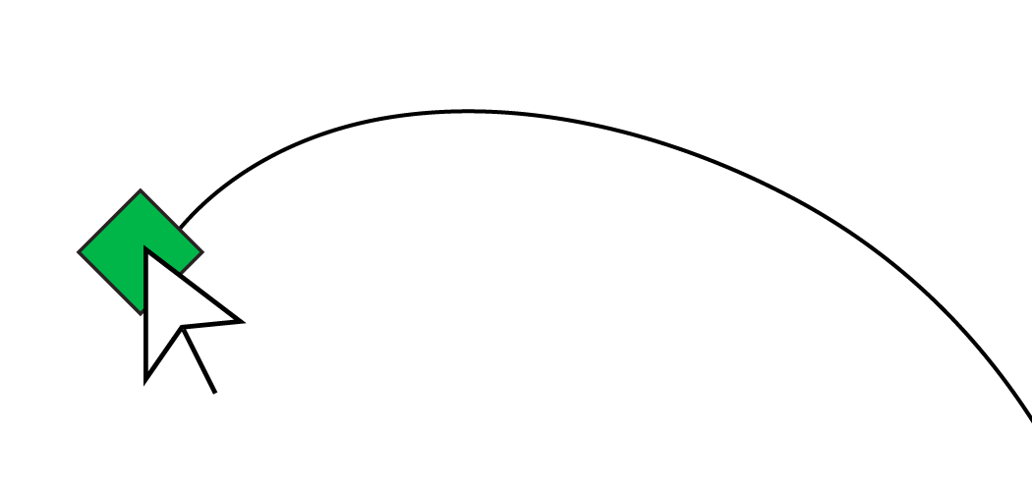
Why do you have to compete in Kaggle?
Improve your AI practical skills.
Learn how to apply the state of the art.
See the implications of your decisions during building the model (i.e. learn what overfitting really mean.) (btw, have you heard about shake up?👀)
Compare yourself against the tops in the world. (You may be able to get over them).
Get some prizes👀
Fun :)
Notes:
Discuss how kaggle improved your skills, what happen during a comp, after a comp, examples of how you used this knowledge in your projects.

Slide 6
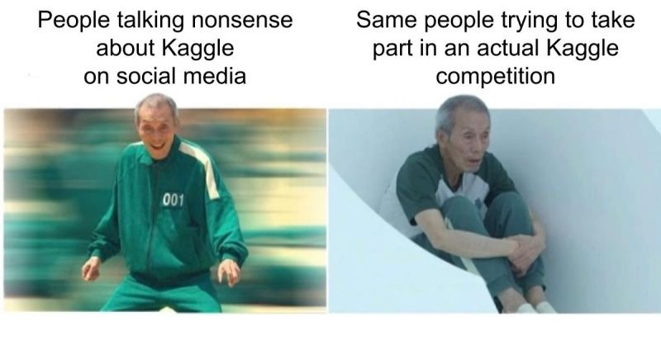
Why do you have to compete in Kaggle?
Notes:
Discuss how kaggle improved your skills, what happen during a comp, after a comp, examples of how you used this knowledge in your projects.

Slide 7

Exploring AI Competitions
Have you heard about shakeup?👀

Slide 8

What are AI comps?
You after the first submission:
You will be given a real-world task coming from any discipline (e.g. medicine, finance, sports, astronomy,..)
You should gather some domain knowledge about the topic, read about it, then choose the model that best solves the problem.
Notes:
I should add images from datasets here.

Slide 9

What are AI comps?
Dataset:
You will be given a two datasets for this task (or asked to gather a one lol).
Training and testing datasets.
You should train your model on the training data then make predictions for the testing data.
These predictions are the submission file for the competition.
train
Train & validate model
Ready to Predict Model
test
Predict test
Results (y_pred) csv file usually

Slide 10
Example of Dataset samples
Index | Weight (g) | Wingspan (cm) | Price? | Back color | Species
1 | 100.1 | 125.5 | 10 | Brown | Buteo jamaicensis
2 | 3000.7 | 200.0 | 98.1 | Gray | Sagittarius serpentarius
3 | 3300.0 | 220.3 | 110.2 | Gray | Sagittarius serpentarius
4 | 4100.0 | 136.0 | 154 | Black | Gavia immer
5 | 3.0 | 11.0 | 2 | Green | Calothorax lucifer

Slide 11
Leaderboard 🤔
Leaderboard:
Oh bro, have you heard about shakeup?👀
There are 2 leaderboards. Public and Private.
Public LB: running while the competition is running.
Private LB: When the competition finishes the private lb will get revealed and the final ranking will depend on the private.
But why do we need this split for test data?🤨
Price
13495
16500
16500
13950
17450
15250
Public Leaderboard
Private Leaderboard

Slide 12


Slide 13
Leaderboard 🤔
You might overfit the leaderboard
Leaderboard:
We need private LB to drop solutions that overfitted to the public LB.
This is to assure your solution is generalizable, working and reliable.
When many people overfits the public LB and the private LB get all over the place, we call this shake up.
But how to avoid overfitting? By having a robust validation (more details next).
Price_pred
13490
16562
165315
35134
20518
29516
Price-True
13495
16500
16500
13950
17450
15250
Public Leaderboard
Private Leaderboard

Slide 14
AI Competitions Goals
Efficiency: There are many constraints in the competitions (e.g. limited GPUs, limited inference time,...)
Performance: The current state of the art is the baseline for the competition. So in many times you have to beat the SOTA to win (or maybe not).
Handle Big Data: Sometimes data sets can go up to 700GB. How could you decrease this data size with minimal loss in information so you can handle it in your device? How to load it to your model fast enough to finish within a reasonable time? How to do inference later with this amount of data?

Slide 15
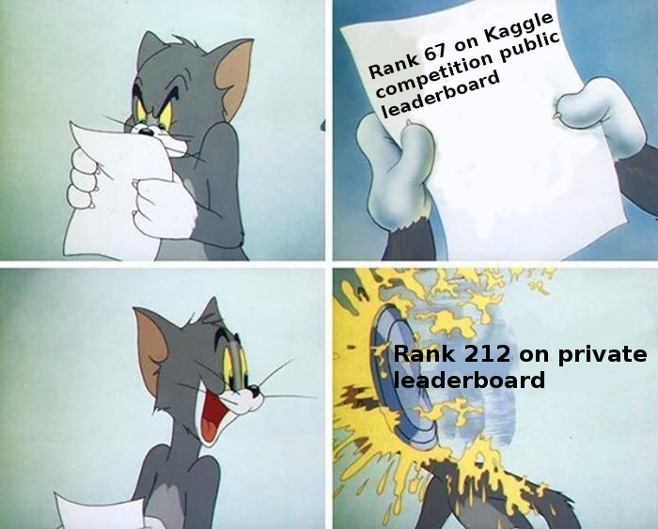
AI Competitions Goals
Ideal Dataset: Sometimes the dataset for the competition is not enough for winning. You have to search for datasets in the internet or check pretrained models.
Avoid overfitting: Having robust validation split would make your model robust against shakeups (I hope lol).

Slide 16
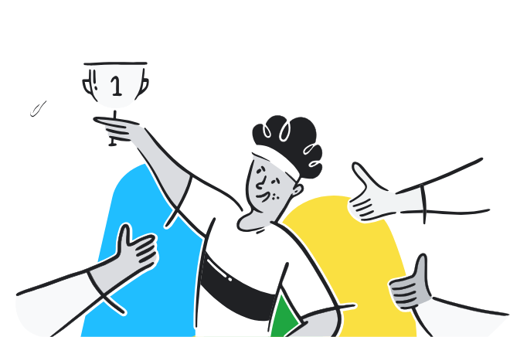
What are AI comps?
Let’s explore it a bit:
Kaggle: Your Home for Data Science
Notes:
explain:
- There is code section where people share baselines.
- There is a discussion section where people share domain knowledge, approaches to solve the problem, cv vs lb threads...etc
- Ranks and tiers

Slide 17
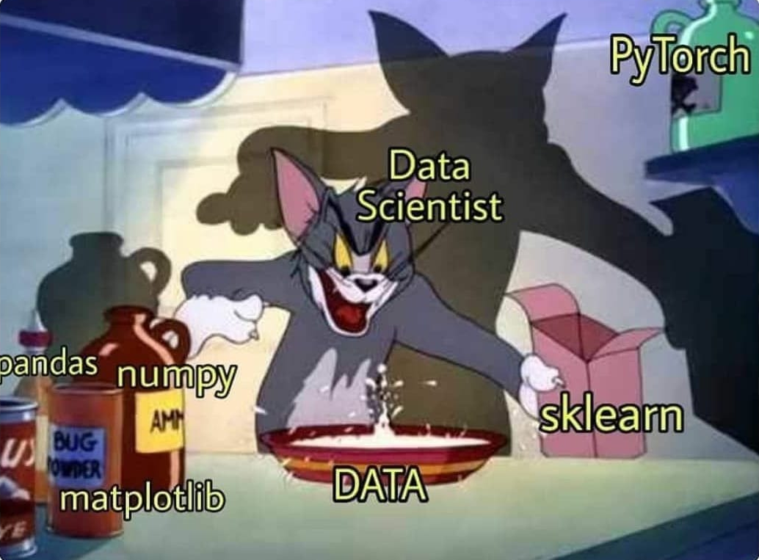
Mastering AI Competitions
Understand your Toolkit

Slide 18

Understand Your Toolkit
Let’s start by a quick revision for data types…
Tabular Data
Time Series Data
Waves (e.g. Audio)
Text
Images
Videos

Slide 19
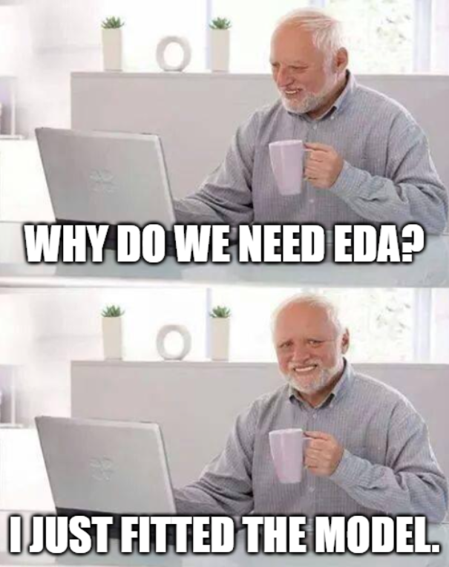
Understand Your Toolkit: EDA
Exploratory Data Analysis (EDA) is to explore your data by looking into raw samples, statistics or plots to gain useful insights about your task.
Why do we need it?🤨

Slide 20
Understand Your Toolkit: EDA
Exploratory Data Analysis (EDA) is to explore your data by looking into raw samples, statistics or plots to gain useful insights about your task.
Why do we need it?🤨
Get comfortable with the data.
Determine how to approach the problem.
Determine what is the best cv.
Determine the most important features (How can you do that?👀).
Determine any strange behaviour in features’ distributions or features’ correlation with each other.
Discover serious problems with the data (e.g. Leakage ).
Find magic features👀

Slide 21
Understand Your Toolkit: EDA
Good EDA could be the key for winning a competition.
Examples:
AMP®-Parkinson's Disease Progression Prediction | Kaggle
Google Research - Identify Contrails to Reduce Global Warming | Kaggle

Slide 22
Understand Your Toolkit: EDA
Tools & Techniques:
Plots: Ordinary EDA.
T-SNE/UMAP: Visualize high dimensional data. Link
Trees Models: Detect important features. Link
LOFO/SHAP: Better features selection tools. Link
Adversarial Validation: Detect Distribution Shift. Link
…
Notes:
Tell how you used Adversarial validation to choose cv in AES

Slide 23

t-SNE short-movie showing how the NN behave during training.
Reference: American Express - Default Prediction | Kaggle

Slide 24
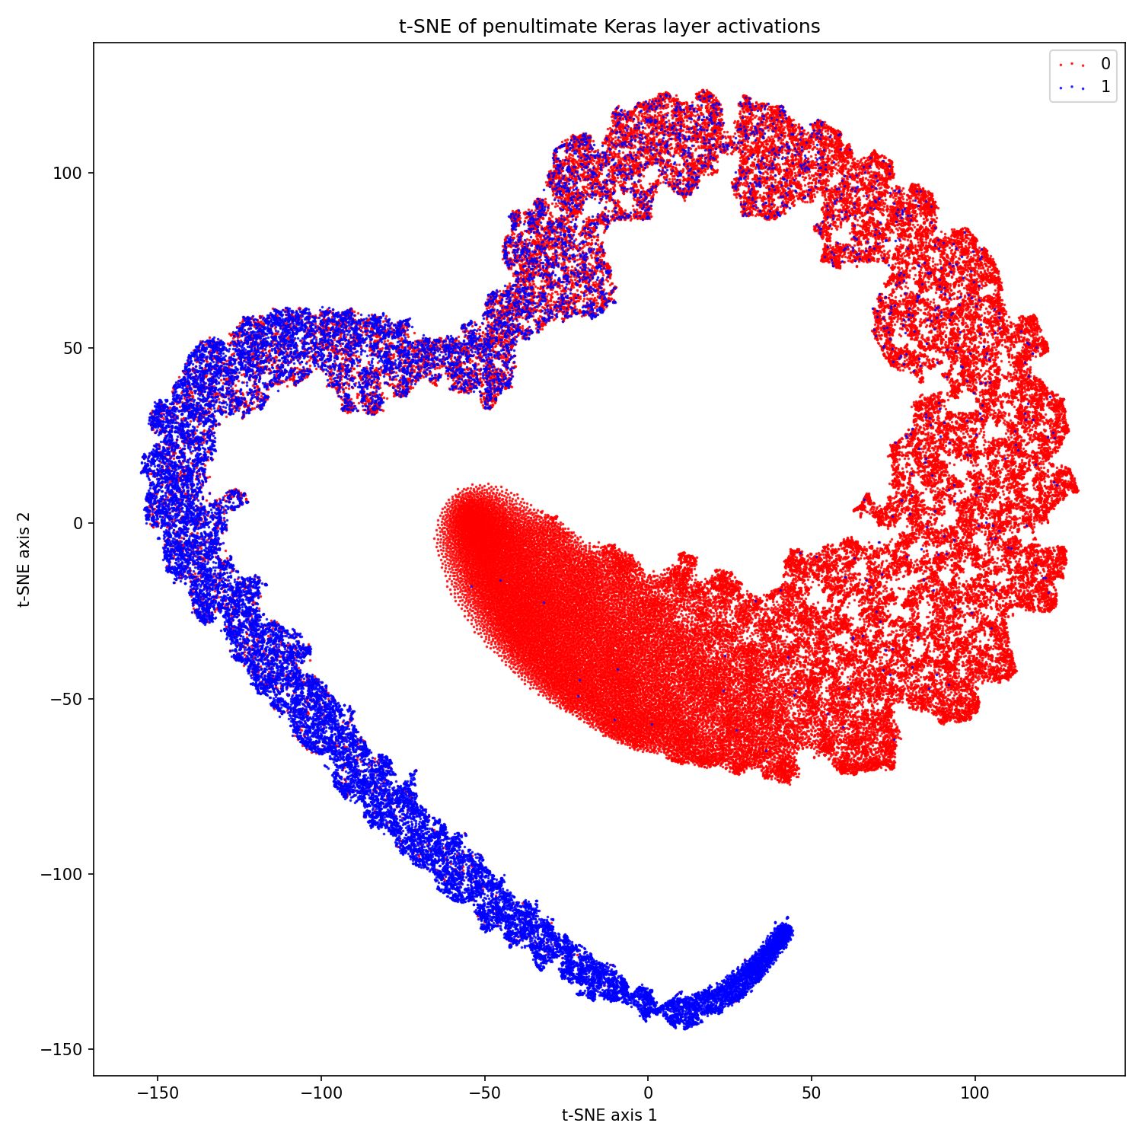

Slide 25
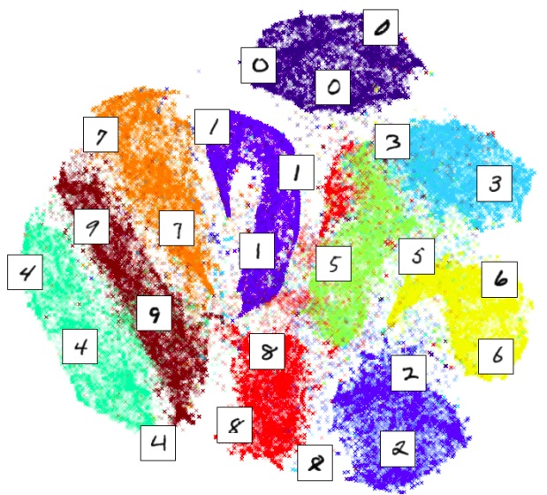

Slide 26
Understand Your Toolkit: Data Preprocessing
Tabular/Time-series Data:
Encoding (Label, One-Hot,Frequency,...)
Feature Engineering (Aggregations, Lags, Differences,...). Link
Features Selection (Trees, LOFO, SHAP,...)
Normalization (maybe not?)
…

Slide 27
Understand Your Toolkit: Data Preprocessing
Images/text data:
Images Normalization.
Augmentations
Text Cleaning
Text Tokenization
…

Slide 28
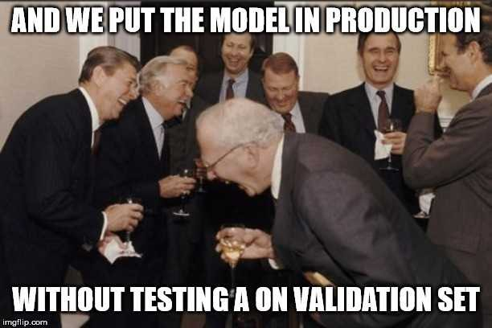
Understand Your Toolkit: Validation
The most important step in the beginning of any project/competition is to choose the correct train/validation split.
Choosing the incorrect split would lead to wrong evaluation making the all the next steps useless.

Slide 29
Understand Your Toolkit: Validation
Types of Data Split:
Hold-out fold: Splits data into a single training set and a single validation set.
KFold: Divides data into k subsets and uses each subset as a validation set while training on the remaining k-1 subsets.
StratifiedKFold: Similar to KFold, but ensures that each fold maintains the same proportion of class labels as the entire dataset.
GroupKFold: Splits data into k folds while preserving the grouping of samples within each fold.
TimeSeriesSplit: Divides data into training and validation sets in a manner that respects the temporal order, suitable for time series data.
Their Combinations…Link

Slide 30

Understand Your Toolkit: Validation
How to know if your score is good or not?
Make a Baseline then compare your subsequent scores against it.

Slide 31
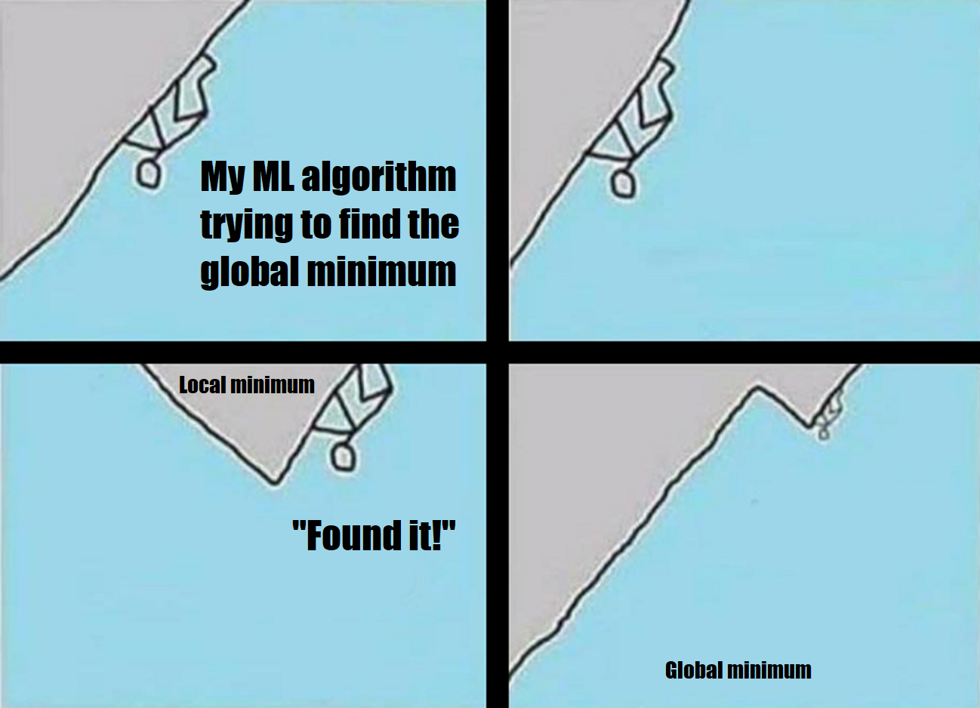
Understand Your Toolkit: Optimizers
Optimizers: Algorithms used to minimize your loss and update your model parameters.
Types: SGD, SGD with Momentum, RMSprop, Adam, AdamW…etc
The best one is …?🤨

Slide 32
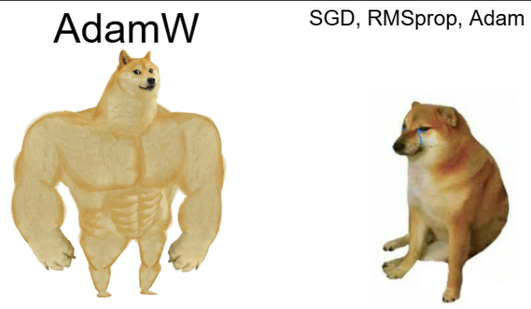

Slide 33
Understand Your Toolkit: Schedulers
Schedulers: Decay (decrease) the learning rate over time.
Why? Increases the stability of the model a lot.
Types: Linear (step decay), Exponential, Cosine, Polynomial, Reduce-on-plateau…etc
The best one is …?🤨

Slide 34
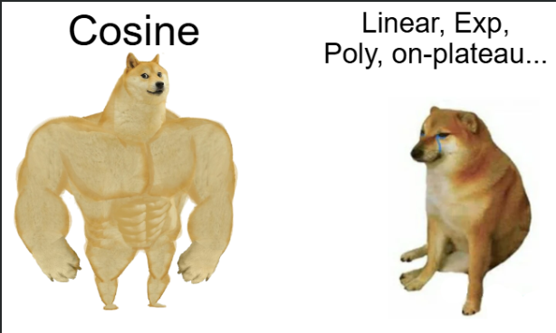

Slide 35
Understand Your Toolkit: Training Stability
To make the training stable we have these components work together:
Optimizer
Scheduler
Batch size
Initial Learning Rate
Warm-up steps
Number of Epochs
Notes:
Explain how to set these params

Slide 36
Understand Your Toolkit: Efficiency
Data Processing:
Cudf: Pandas on GPU
Polars: Pandas with multi-thread
ML Algorithms:
Cuml: Sklearn on GPU
DL Algorithms:
ONNX: Speed up for inference in CPU
Mixed Precision / Quantization: Lower size
Knowledge Distillation: Student model (small) try to learn from (replicate) a teacher model (big).
…

Slide 37
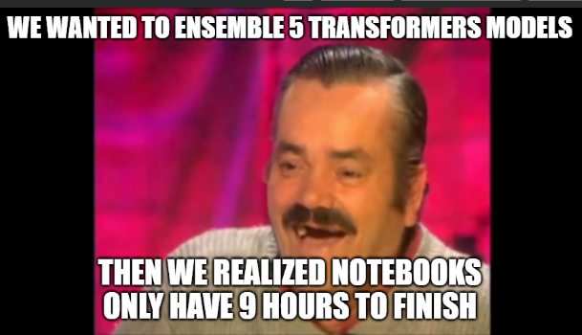
Understand Your Toolkit: Ensembling
Why using only one model? Let’s use several ones then use a weighted average!

Slide 38
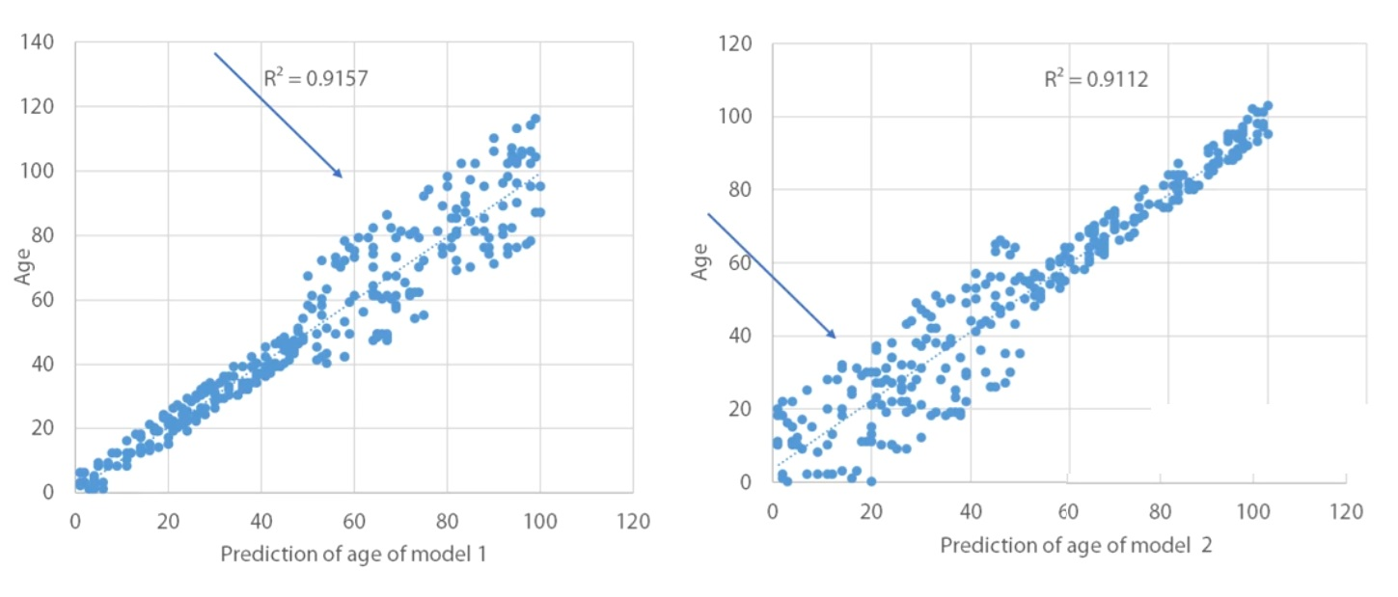

Slide 39
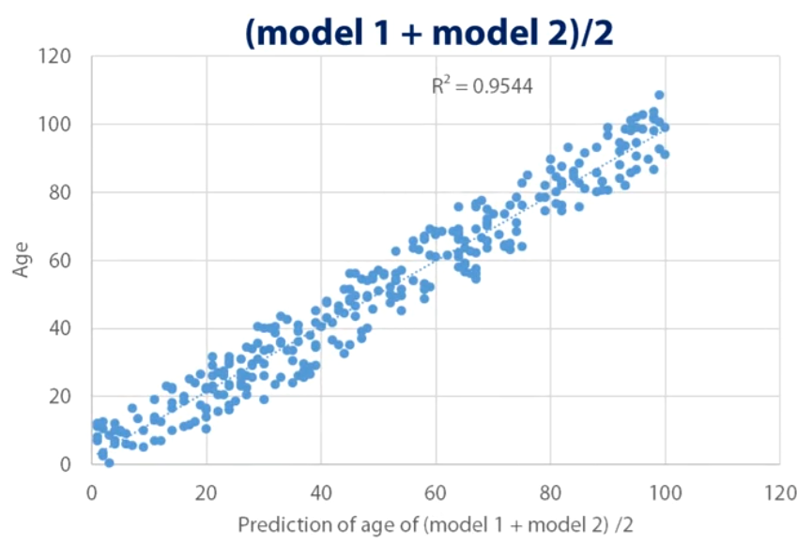

Slide 40
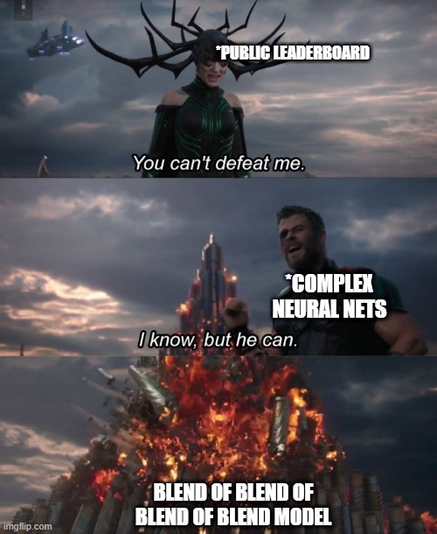
Types of Ensembling:
Averaging (or Blending)
Bagging
Stacking

Slide 41
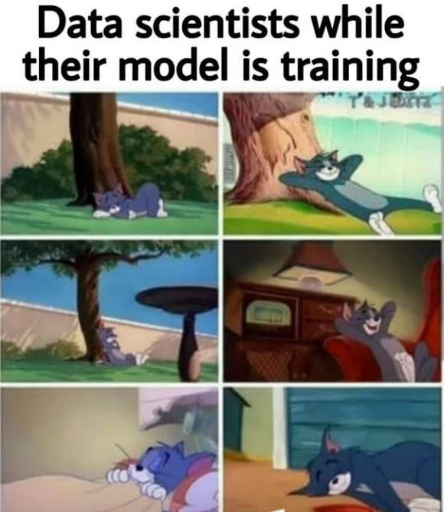
Choosing The Best Models
It’s all about the assumptions.

Slide 42
Revisit Data Types…
Do we have a more high level approach/view to see these types of data?
Tabular Data
Time Series Data
Waves (e.g. Audio)
Text
Images
Videos

Slide 43
Revisit Data Types…
Classify the data types based on their properties (assumptions):
Tabular (non-sequential): Order of features doesn’t matter.
Sequence: Order does matter.
Neighborhood: Each feature has a relation with its neighbors.
Graph: Generalized Neighborhood.
Sequential Decision-making: Sequence + feedback influencing future decisions.
Notes:
Explain how to set these params

Slide 44
Data Assumptions
Classify the data types based on their properties (assumptions):
Tabular (non-sequential): Tabular Data.
Sequence: Time-series data, text data, waves data.
Neighborhood: Images.
Graph: Graph-based data (e.g. molecular structures,...)
Sequential Decision-making: Decision-making environments (e.g. playing games, robotics, …)
Notes:
Explain how to set these params

Slide 45
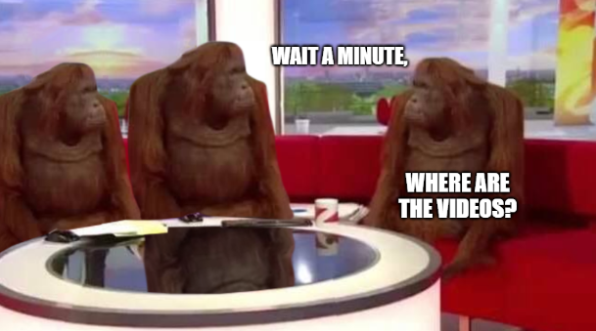
Notes:
Explain how to set these params

Slide 46
Data Assumptions
Classify the data types based on their properties (assumptions):
Tabular (non-sequential): Tabular Data.
Sequence: Time-series data, text data, waves data.
Neighborhood: Images.
Graph: Graph-based data (e.g. molecular structures,...)
Sequential Decision-making: Decision-making environments (e.g. playing games, robotics, …)
Combination between them: Videos (Sequence+Neighborhood)
Notes:
Explain how to set these params

Slide 47
Models Assumptions
Classify the data types based on their properties (assumptions):
Tabular (non-sequential): Machine Learning models.
Sequence: Sequence models (LSTM/Transformer/1D CNN)
Neighborhood: (1D CNN/2D CNN/3D CNN)
Graph: Graph NN
Sequential Decision-making: Reinforcement Learning
Combination between them: e.g. (for videos: CNN + Sequence)
Notes:
Explain how to set these params

Slide 48
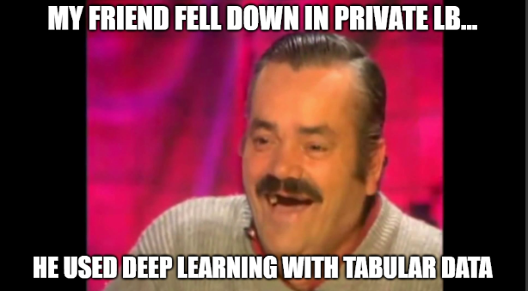
Models & Data Assumptions
So, to figure out the right model, you should know the properties/assumptions you have in your dataset then choose the appropriate models.
Notes:
Explain how to set these params

Slide 49
Practical Tips and Strategies
It’s all about the assumptions.

Slide 50
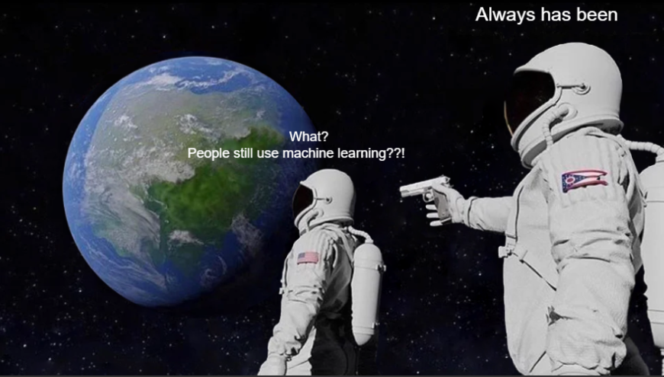
ML Models:
ML Models are the SOTA in tabular data.
Types of models:
Linear Models.
Kernel Models.
Trees Models.
Notes:
Explain how to set these params

Slide 51
ML Models:
Linear Models: Linear Regression / Logistic Regression
Best when there is a linear relationship between the features and the target variable.
Most stable model.
Used widely in time-series forecasting due to high relationship between target and lags.
Best Versions: Ridge, ElasticNet, Lasso. (in sklearn).
Forecasting variants: Arima, Facebook Prophet,...
Notes:
Relevant Comps: Tokyo…

Slide 52
ML Models:
Kernel Models: SVM
Best when there is a very big number of features.
Quite slow for samples > 5K (How to solve this?👀).
Used sometimes as a head for embeddings extracted from the models because it can handle high dimensionality. Link
Best Versions: SVM (in sklearn), and …?👀
Notes:
Explain how to set these params

Slide 53
ML Models:
Kernel Models: SVM
Best when there is a very big number of features.
Quite slow for samples > 5K (How to solve this?👀).
Used sometimes as a head for embeddings extracted from the models because it can handle high dimensionality. Link
Best Versions: SVM (in sklearn), SVM (in cuml - very fast).
Notes:
Relevant comps: AES,...

Slide 54
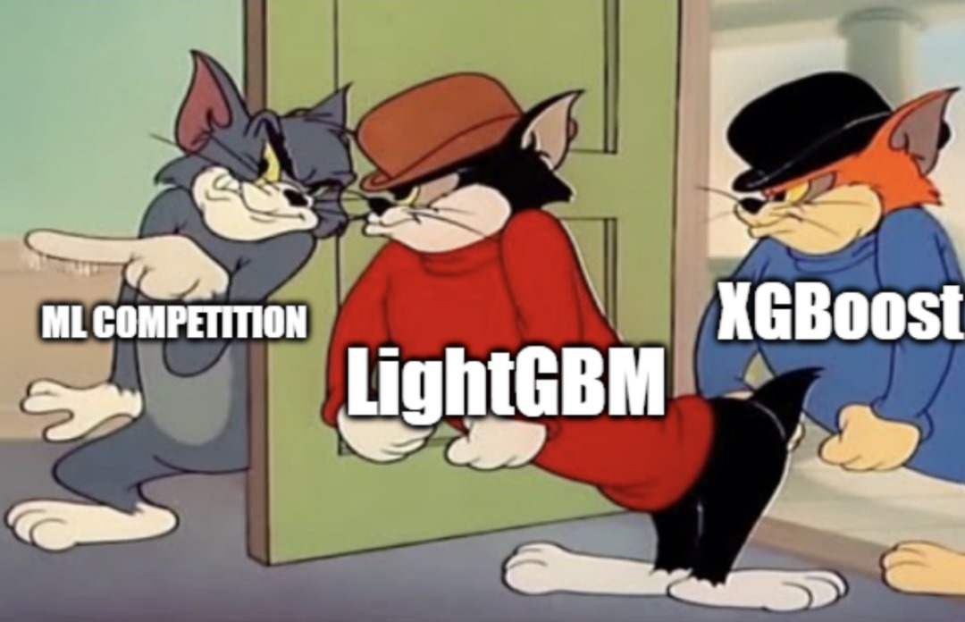
ML Models:
Trees Models:
Generally the best ML algorithms.
Types:
Decision Trees
Random Forest
Gradient Boosting (GBDT):
XGBoost: 👑
LightGBM: Fast in CPU
Catboost: Best baseline
Notes:
Relevant comps: AES,...

Slide 55
ML Models:
Examples:
American Express - Default Prediction | Kaggle
ISIC 2024 - Skin Cancer Detection with 3D-TBP | Kaggle
Enefit - Predict Energy Behavior of Prosumers | Kaggle
Notes:
Relevant comps: AES,...

Slide 56
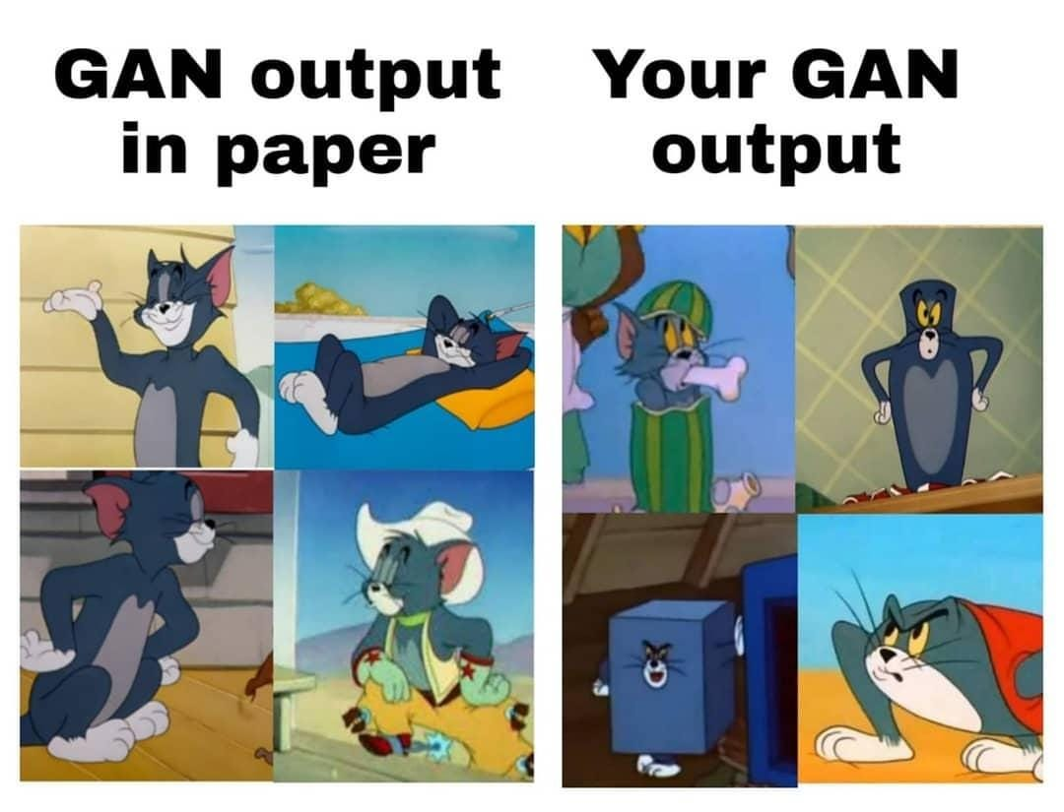
DL Models:
DL Models are the SOTA in everything except tabular (time series is in-between but mostly ML is better).
Notes:
Explain how to set these params

Slide 57
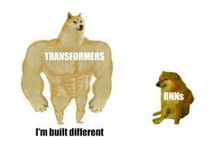
NLP Tasks
Best Models: Transformers
Needs finetuning: (👑Deberta👑, Roberta,...)
Zero-shot: (Recent LLMs)
Best Library: “transformers” by Huggingface🤗.
Notes:
Explain how to set these params

Slide 58
NLP Tasks
NLP models are quite powerful already. Therefore, the improvements in LBs would be small.
How to improve your results?
Clean your data properly.
Tune your parameters. They have high effects here.
Find models that are pre-trained on data similar to your task (you can use Huggingface).
Ensembling (averaging, stacking)
Manipulate the architecture and the embeddings. Link Link
Data-based ideas.
Check previous solutions.
Notes:
Explain how to set these params

Slide 59
NLP Tasks
Notes:
If the task is regression, disable dropout to get more stable training. Link
Transformers needs very low learning rates (e.g. 1e-5, 2e-5)
Schedulers and warmup are widely used in NLP.
NLP models are usually finetuned using 1-3 epochs only before overfitting. (why?👀)
LLMs are trained mostly on <= 1 epoch.
Scheduler should work on the steps, not the epochs.
NLP models are huge (e.g. xsmall deberta has ~70M params)
Recenely, a very interesting pattern appeared where Deberta could get beaten by LLMs in classification IF the data came from LLMs.
Notes:
Explain how to set these params

Slide 60
NLP Tasks
Examples:
Feedback Prize - English Language Learning | Kaggle
Learning Agency Lab - Automated Essay Scoring 2.0 | Kaggle
LMSYS - Chatbot Arena Human Preference Predictions | Kaggle
AI Mathematical Olympiad - Progress Prize 1 | Kaggle
Kaggle - LLM Science Exam | Kaggle
Some good baselines:
AES-2 | Multi-class Classification [Train] (kaggle.com)
[Training] Gemma-2 9b 4-bit QLoRA fine-tuning (kaggle.com)
Notes:
Explain how to set these params

Slide 61
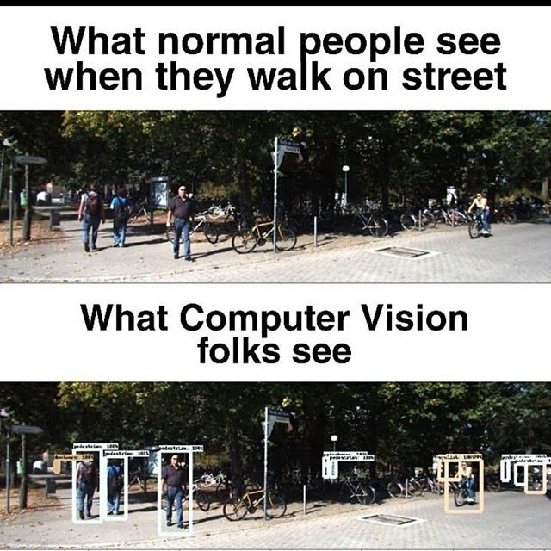
Computer Vision
Best Models:
EfficientNet
ResNet
ViTs - Swin Transformers
ConvNeXt
Best Library:
Models: 👑Timm👑, Torchvision.
Augmentations: 👑Albumentations👑, Torchvision.
Notes:
Explain how to set these params

Slide 62
Computer Vision Tasks
Classification: EfficientNet, ResNet, ViT,..
Segmentation (2D/2.5D/3D): 👑Unet-based archs👑, Mask RCNN,...
Detection: 👑DETR (DEtection TRansformer)👑, YOLO, EfficientDet, Faster RCNN,...
How to improve your results? Everything in NLP +..
👑Augmentations👑
TTA (Test-time augmentations).
Data-based ideas.
Notes:
Explain how to set these params

Slide 63
Computer Vision Tasks
How to choose the appropriate augmentations? 👑Error Analysis👑
Train a baseline.
Make predictions on your validation data.
Inspect the worst predicted images, these predictions should guide you to the problems the model facing.
Examples:
Failure with very small objects: Scale augmentation.
Failure with different colors / environment: Color augmentations.
Failure with rotated images: Rotation augmentations.
Failure with Blurry images: Noise augmentations.
…etc
Notes:
Explain how to set these params

Slide 64
Computer Vision Tasks
Notes:
Smaller models can be better than bigger models in many times.
Computer vision models are small. Training is fast compared to NLP.
You will need a bit bigger lr if you use CNN-based model (e.g. 1e-4,1e-3) and small one if you use Transformer-based model (e.g. 1e-5,2e-5).
You may need big number of epochs (e.g. 5-200). It depends on the task.
Using wrong augmentations can decrease performance significantly.
Scheduler based on epochs not steps.
Notes:
Explain how to set these params

Slide 65
Computer Vision Tasks
Examples:
Google Research - Identify Contrails to Reduce Global Warming | Kaggle
RSNA 2022 Cervical Spine Fracture Detection | Kaggle
Vesuvius Challenge - Ink Detection | Kaggle
RSNA Screening Mammography Breast Cancer Detection | Kaggle
Resources:
Kaggle Days Paris 2022_Philipp Singer & Yauhen Babakhin_Practical Tips for Deep Transfer Learning - YouTube
Notes:
Explain how to set these params

Slide 66

Notes:
Explain how to set these params

Slide 67
Waves
Best Models:
1D-CNN (e.g. WaveNet,..)
and… 👀👀
Notes:
Explain how to set these params

Slide 68
Waves
Best Models:
1D-CNN (e.g. WaveNet,..)
2D-CNN (e.g. EfficientNet,..) (What?🤨)
Notes:
Explain how to set these params

Slide 69
Waves
Best Models:
1D-CNN (e.g. WaveNet,..)
2D-CNN (e.g. EfficientNet,..) (What?🤨)
Waves can be converted into an image representation called Spectrograms. Then we fit CNN on it.👀
Notes:
Explain how to set these params

Slide 70
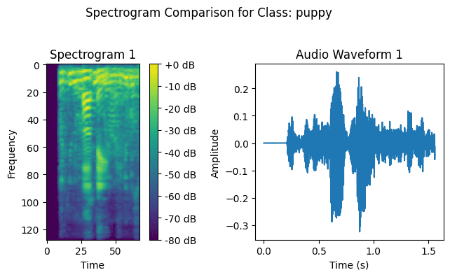
Notes:
Explain how to set these params

Slide 71

Waves
Fitting on spectrograms is the SOTA👀👀👀👀👀.
Notes:
Explain how to set these params

Slide 72

Waves
Examples:
BirdClef 2023: Pytorch Lightning-Training w/ cMAP (kaggle.com)
HMS - Harmful Brain Activity Classification | Kaggle
Notes:
Explain how to set these params

Slide 73
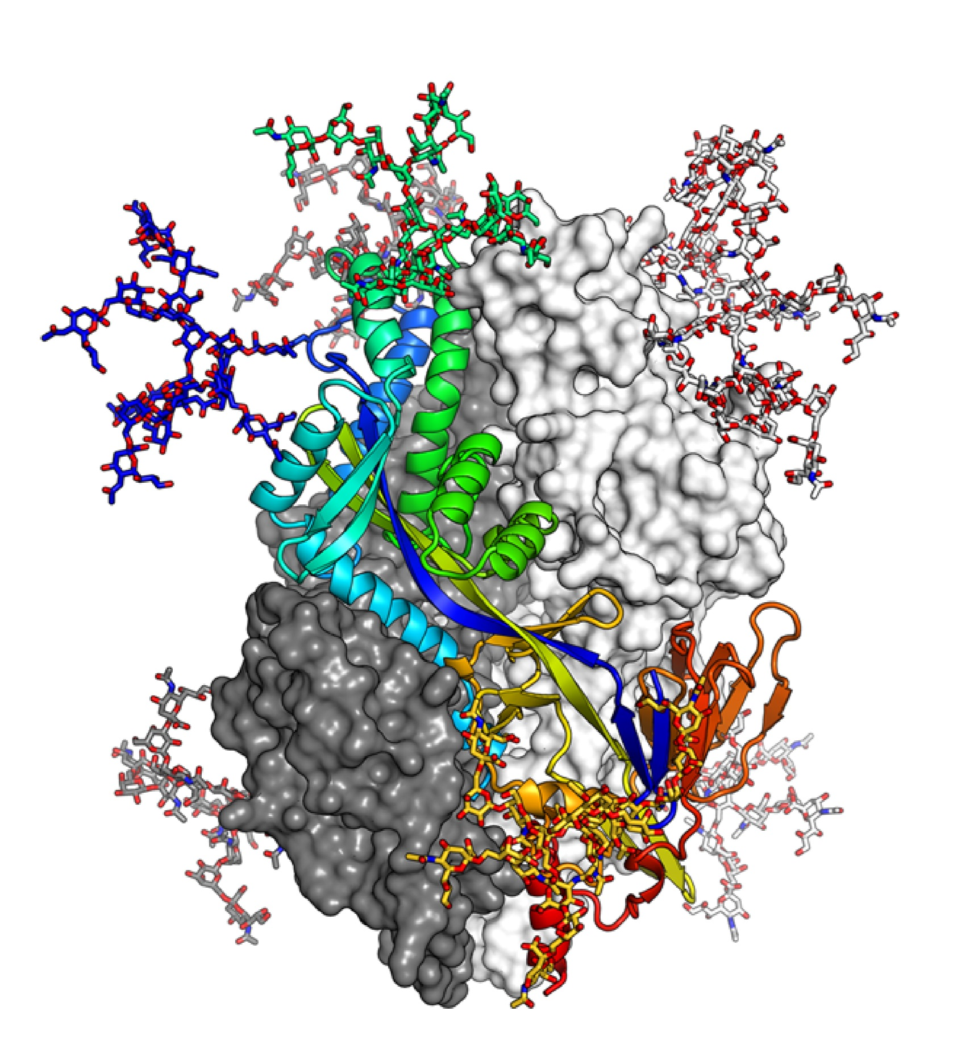
Proteins & DNA Sequences
Per-Char Sequences.
Can be approached using NLP models.
Sometimes, it can be converted to 3D images, then approached as 3D CNN.
Can be approached using Graph NN as well.
Notes:
Explain how to set these params

Slide 74
Proteins & DNA Sequences
Examples:
Novozymes Enzyme Stability Prediction | Kaggle
NeurIPS 2024 - Predict New Medicines with BELKA | Kaggle
Stanford Ribonanza RNA Folding | Kaggle
Notes:
Explain how to set these params

Slide 75

AI & Security
CTF but for AI👀.
Learn about Adversarial attacks, LLM jailbreaking and some random stuff👀.
Examples:
AI Village Capture the Flag @ DEFCON31 | Kaggle
AI Village Capture the Flag @ DEFCON | Kaggle
Notes:
Explain how to set these params

Slide 76
Final Notes: How do you approach a new competition?
Start with reading discussions, understanding the domain knowledge, then summarize everything important.
Read the baselines, do eda and choose the best validation.
if you have time, build your own baseline from scratch then replicate all the ideas in the best public nbs into yours. Otherwise, choose a public nb then build on it.
Then add your ideas🫡.
Notes:
Explain how to set these params

Slide 77

Final Notes: Difference between Kaggle Competitions and real-world projects?
Problem Definition.
Data Availability.
Model Deployment.
Evaluation Metrics.
Resources and time constraints.
Notes:
Explain how to set these params

Slide 78

Conclusion
Ok you know the best models then what? Just applying them to win?
⇒ The real work is in the data part.
Have fun and keep learning!🫡
(Don’t forget to eat and sleep btw👀)
Thanks for Attendance!
Notes:
Explain how to set these params

